Slide 1
ROC and AUC
What? Why? How?

Slide 2
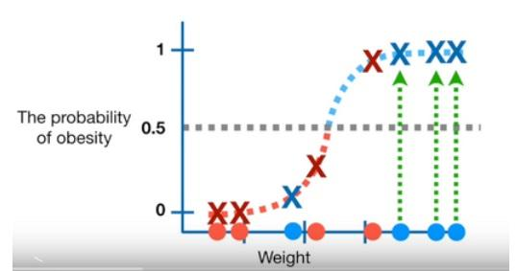
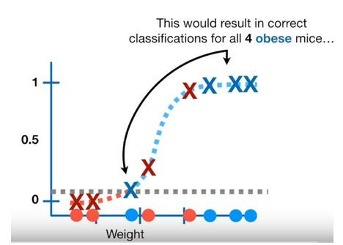
ROC An ROC curve (receiver operating characteristic curve) is a graph showing the performance of a classification model at all classification thresholds. ROC mostly used for binary classification
Threshold can be any number between [0;1]

Slide 3
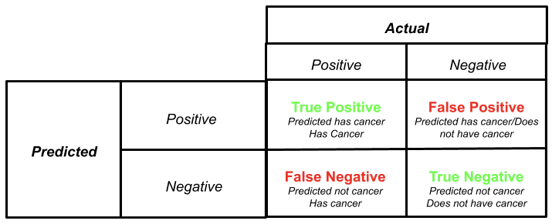
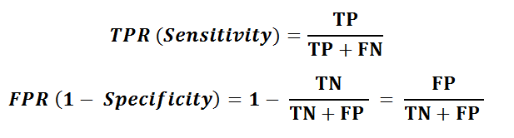
tt
True Positive Rate tells us what proportion of obese samples were correctly classified
False Positive Rate tells us the proportion of not obese samples that were correctly classified and are False Positive

Slide 4
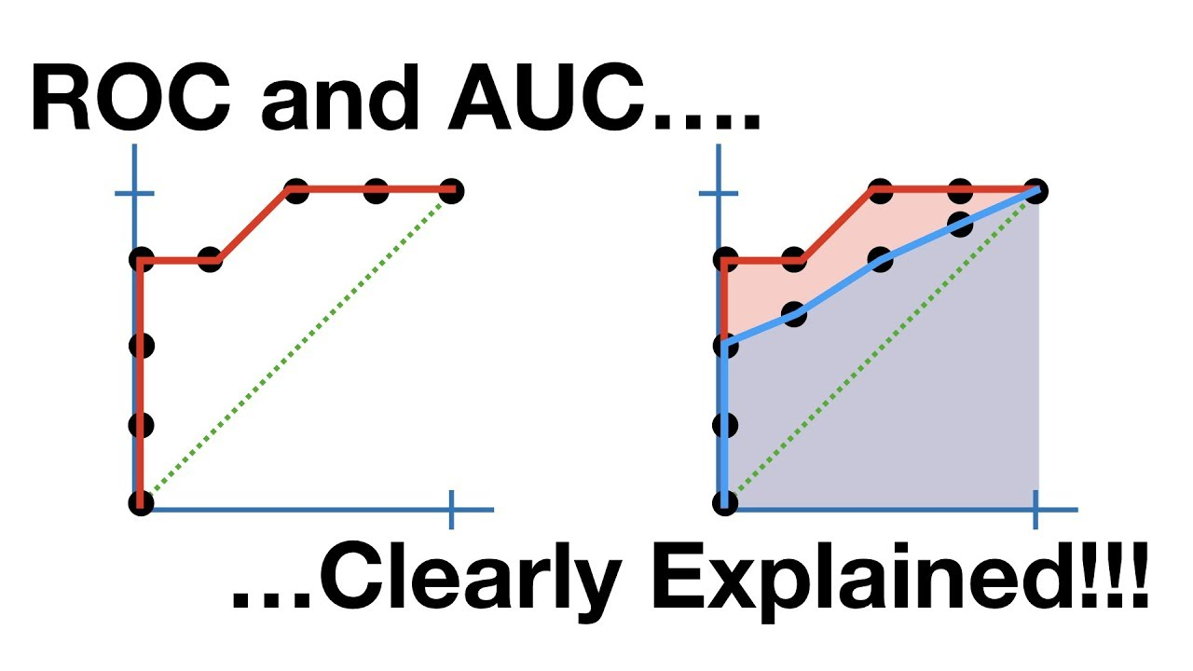
Trsh = 0.5
tt
Trsh = 0
3
1
3
1
TPR = 0.75
FPR = 0.25
4
3
1
0
TPR = 1
FPR = 0.75
Trsh = 0.1 Trsh = 0.9 Trsh = 1
4
TPR = 1
FPR = 0.5
0
2
2
0
TPR = 0.75
FPR = 0
3
1
4
4
4
0
0
TPR = 1
FPR = 1

Slide 5
So instead of being overhelmed with confusion matrices, ROC graphs provide a simple way to summarize all of the information
True positive Rate = False Positive Rate
Good model Should be above this line

Slide 6
Area Under Curve(AUC)
The AUC makes it easy to compare one ROC to another
ROC curves make it easy to identify the best threshold for making decision
AUC can help you decide which categorization method is better

